Slide 1
for Christmas
Powered by Create Direct

Slide 2
What is Rewardiful for Christmas?
Rewardiful is the
online application that allows you to create your own Xmas shop for your clients in just 24 hours
Over 100.000 prizes available
Prize catalog and prize management application built in
Logistics included
(prizes acquisition, storage, dispatching)
Return & warranty management included

Slide 3
What is Rewardiful for Christmas?
Xmas is not just a reason of joy,
but a Rewardiful module for managing Xmas presents orders for your customers:
Create a Rewardiful Christmas Shop
Adding the X-mas Gifts in your Rewardiful Shop
Importing the database of your clients and credits for gifts
Processing the orders
Logistics

Slide 4
Rewardiful for Xmas
Benefits

Slide 5
Rewardiful for Christmas benefits
One application for managing X-mas gifts management flows.
Import the gifts in the online rewards catalog
Allocating credits to buy the gifts
Live prize stock management – for merchandise products
Send reminder to customers who did not ordered the X-mas Gift
Application connected to Atlas for order processing and Mediapost Hit Mail WMS, for logistics.
Fast & secure

Slide 6
Rewardiful for Xmas
How it works?

Slide 7
Rewardiful for Christmas benefits
We process the order and send the gift
Client order this Xmas gift
5
Import credits for each client
5
4
Create Direct
Import the database of clients
3
Setup the Rewardiful Xmas platform
Participant
2
Create Direct
1
Create Direct
Create Direct

Slide 8
Rewardiful for Xmas
Xmas Gifts?

Slide 9
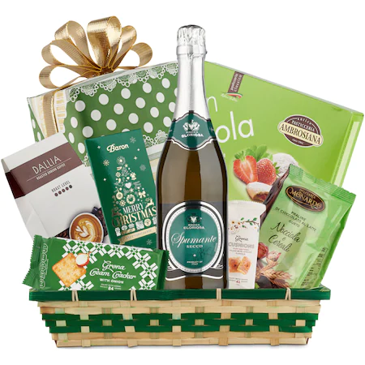
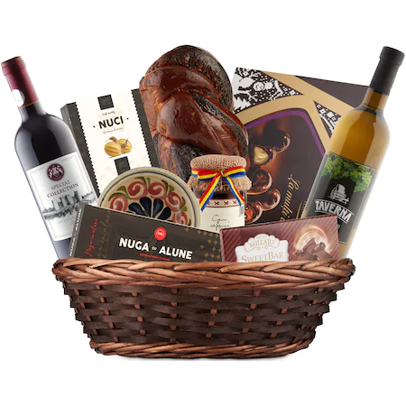
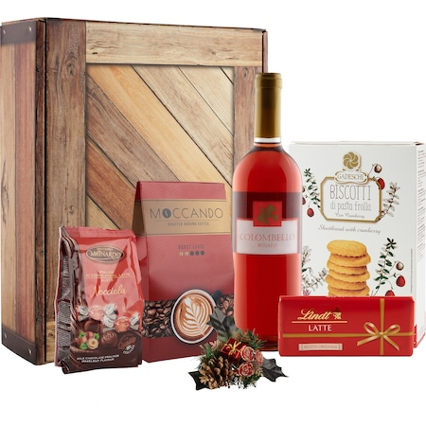
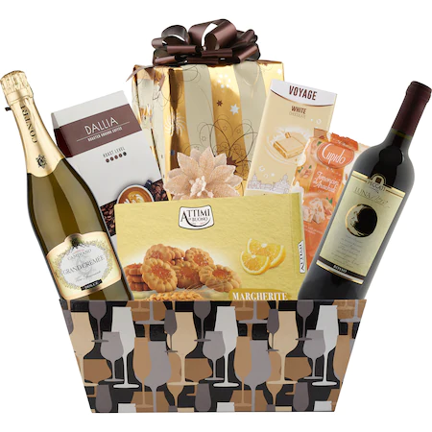
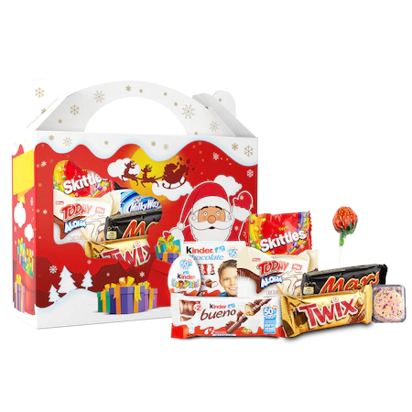
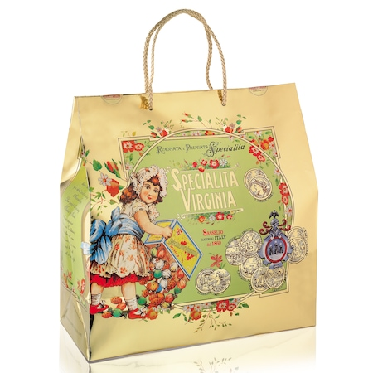
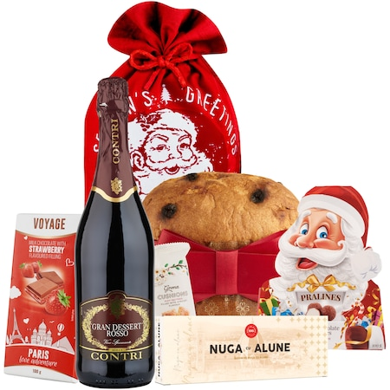
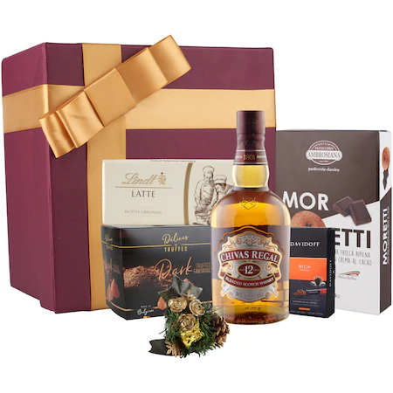
Examples of Christmas gifts
120 RON
220 RON
200 RON
200 RON
60 RON
180 RON
260 RON
310 RON

Slide 10
Rewardiful for Xmas
Logistics?

Slide 11
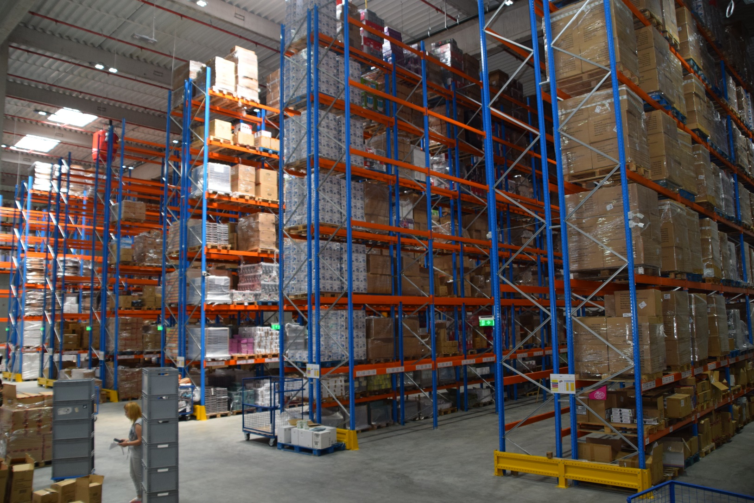
Domestic logistic
Partnership with top 5 logistic companies in Romania
90 % of orders are delivery: in 1-3 days from receiving the order
12.000 sqm logistic hub in Dragomiresti Vale – Bucharest Ring Road
Ability to store atypical goods
Flows of inputs and outputs are fluid – 13 loading/ unloading platforms
05
Bucharest
Prize delivery all over Romania

Slide 12
Domestic logistics - Direct prize delivery from local suppliers and Create Direct
International logistic
Partnerships with local e-commerce platforms in Romania, Bulgaria, Hungary, Poland
Rewards delivery: in 3-5 days from receiving the order
The database with prizes is synchronized in real time with the platforms of our providers
Prize delivery from Romania

Slide 13
Rewardiful for Xmas
Pricing

Slide 14
Rewardiful for Christmas setup
Your Xmas Rewardiful Platform
1990 € (one time) + price of the credits
1490 E
Christmas Offer

Slide 15
HO HO HO…. Thank you!
office@createdirect.ro
+4 021 225 65 52

